Slide 1
Pandas & matplotlib

Slide 2
Pandas
Pandas is a Python library used for working with data sets.
It has supports for analyzing, cleaning, exploring, and manipulating data.
The name "Pandas" has a reference to both "Panel Data", and "Python Data Analysis“.
Pandas allows us to analyze big data and make conclusions based on statistical theories.
Pandas can clean messy data sets, and make them readable and relevant.

Slide 3
Using Pandas
C:\Users\Your Name>pip install pandas
# check pandas version
import pandas
print(pandas.__version__)
# alternative of above code
import pandas as pd
print(pd.__version__)

Slide 4
Pandas DataFrames
Data sets in Pandas are usually multi-dimensional tables, called DataFrames.
Series is like a column, a DataFrame is the whole table.
A Pandas DataFrame is a 2-dimensional data structure, like a 2-dimensional array, or a table with rows and columns.

Slide 5
DataFrames
Dictionary Keys will be column title and Dictionary Values will be inserted as the column values.
Rows of the DataFram can be accessed using index starting from 0.
import pandas as pd
data = {
"calories": [420, 380, 390],
"duration": [50, 40, 45]
}
# create a DataFrame object from dictionary
df = pd.DataFrame(data)
print(df)
Output:
calories duration
0 420 50
1 380 40
390 45

Slide 6
DataFrames
Output:
calories duration
0 420 50
1 380 40
2 390 45
calories 420
duration 50
Name: 0, dtype: int64
calories duration
0 420 50
2 390 45
import pandas as pd
data = {
"calories": [420, 380, 390],
"duration": [50, 40, 45]
}
#load data into a DataFrame object:
df = pd.DataFrame(data)
print(df)
#use a row index:
print(df.loc[0])
#use a list of indexes:
print(df.loc[[0, 2]])
A DataFrame is like a table with rows and columns. Pandas use the loc attribute to return one or more specified row(s). It returns a Pandas Series.

Slide 7
Read CSV
import pandas as pd
df = pd.read_csv('data.csv’)
print(df)
print(df.to_string())

Slide 8
Useful Functions
dropna()
info()
isnull()
apply()
head()
tail()

Slide 9
DataFrames
Output:
calories duration
0 420 50
1 380 40
2 390 45
calories duration
0 840 50
1 760 40
2 780 45
import pandas as pd
data = {
"calories": [420, 380, 390],
"duration": [50, 40, 45]
}
df = pd.DataFrame(data)
print(df)
def make_double(x):
return x * 2
df['calories'] = df['calories'].apply(make_double)
print(df)

Slide 10
Matplotlib
Matplotlib is a low level graph plotting library in python that serves as a visualization utility.
Matplotlib is open source and we can use it freely.
Matplotlib is mostly written in python, a few segments are written in C, Objective-C and Javascript for Platform compatibility.

Slide 11
Using Matplotlib
C:\Users\Your Name>pip install matplotlib
# check matplotlib version
import matplotlib
print(matplotlib.__version__)

Slide 12
Matplotlib Pyplot
Most of the Matplotlib utilities lies under the pyplot submodule, and are usually imported under the plt alias.
The plot() function is used to draw points (markers) in a diagram.
By default, the plot() function draws a line from point to point.

Slide 13
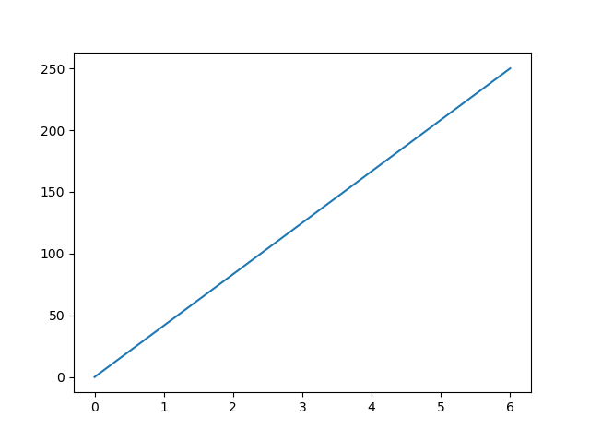
Matplotlib Pyplot
The plot() function is used to draw points (markers) in a diagram.
By default, the plot() function draws a line from point to point.
Most of the Matplotlib utilities lies under the pyplot submodule, and are usually imported under the plt alias.
import matplotlib.pyplot as plt
import numpy as np
xpoints = np.array([0, 6])
ypoints = np.array([0, 250])
plt.plot(xpoints, ypoints)
plt.show()

Slide 14
References
https://www.w3schools.com/python/python_getstarted.asp

